Slide 1
Understanding Workgroups and Active Directory
Lesson 3

Slide 2
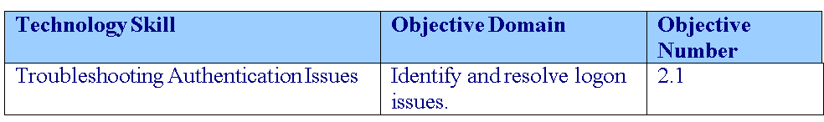
Objectives
Notes:
Outline the material you are going to cover in this lesson. Do not go into detail; each of these points will be expanded on in the lesson. You may also want to mention the Technology Skills that are being covered for the Certification exam.

Slide 3
Workgroup
A workgroup is usually associated with a peer-to-peer network where user accounts are decentralized and stored on each individual computer.
Since each computer has its own security database, when you have several users that need access to the computer (while requiring unique username and passwords), you will need to create a user account for each user on the computer.

Slide 4
Authentication
Authentication is the process of identifying an individual, usually based on a username and password. After a user is authenticated, users can access network resources based on the user’s authorization.

Slide 5
Authorization and Auditing
Authorization is the process of giving individuals access to system objects based on their identity.
Auditing is the process of keeping track of a user’s activity while accessing the network resources, including the amount of time spent in the network, the services accessed while there and the amount of data transferred during the session.

Slide 6
Authentication Methods
A user can authenticate using one or more of the following methods:
What they know: Such as using a password or Personal Identity Number (PIN).
What they own or possess: Such as a passport, smart card, or ID card.
What a user is: Usually using biometric factors based on fingerprints, retinal scans, voice input, or other forms.

Slide 7
Password
The most common method of authentication with computers and networks is the password.
A password is a secret series of characters that enables a user to access a file, computer, or program.
To make a password more secure, you need to choose a password that nobody can guess.
Therefore, it should be long enough and considered a complex or strong password.

Slide 8
Complex Password
Cannot contain the user’s account name or parts of the user’s full name that exceed two consecutive characters.
Must be at least six characters in length or the number of characters specified in the Minimum password length policy setting.
Must contain characters from at least three of the following four categories: English uppercase alphabet characters (A–Z), English lowercase alphabet characters (a–z), base-10 digits (0–9), and non-alphanumeric characters (for example, !$#,%).

Slide 9
User Account
A user account enables a user to log on to a computer and domain. As a result, it can be used to prove the identity of a user, which can then be used to determine what a user can access and what kind of access a user will have (authorization).
It can be used for auditing so that if there is a security problem where something was accessed or deleted, it can be determined who accessed or deleted the object.

Slide 10
User Account
On today’s Windows networks, there are two types of user accounts:
The local user account
The domain user account

Slide 11
Local User Account
A local user account allows a user to log on and gain access to the computer where the account was created.
The security table located on the local computer that stores the local user account is known as the Security Account Manager (SAM) database.

Slide 12
User Accounts
There are three types of local user accounts and each provides the user with different levels of control over the computer.
Administrator
Standard
Guest

Slide 13
User Accounts
Windows 7 provides two separate interfaces for creating and managing local user accounts:
User Accounts in the Control Panel
Local Users and Groups MMC snap-in
Both of these interfaces provide access to the same user and group accounts stored in the SAM, so any changes you make using one interface will appear in the other.

Slide 14
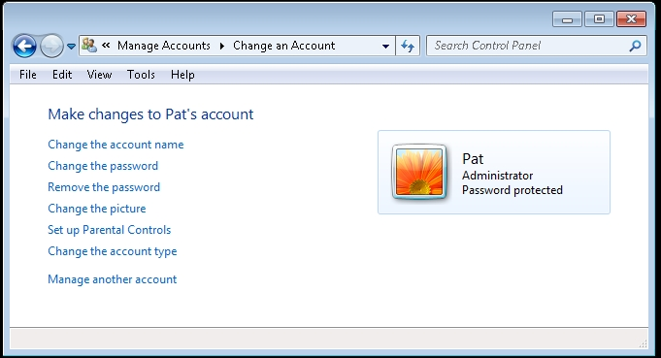
User Accounts Control Panel

Slide 15
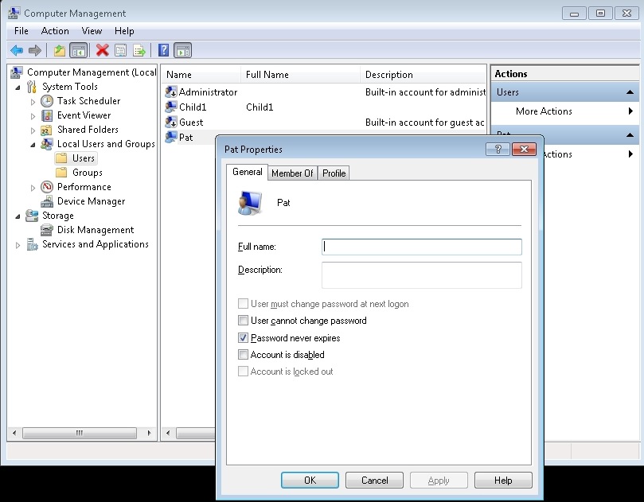
Local Users and Groups Snap-in

Slide 16
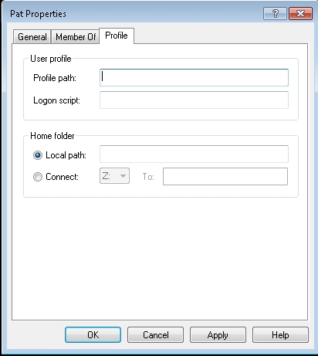
Local Users and Groups Snap-in

Slide 17
User Profile
A user profile, which is a collection of folders and data that store the user’s current desktop environment and application settings, is associated with each user account.
A user profile also records all network connections that are established so when a user logs on to a computer, it will remember the mapped drives to shared folders.
When a user logs on to a computer, they will get the same desktop environment that they previously had on the computer.
For Windows 7, the profiles are stored in the C:\Users folder.

Slide 18
Credential Manager
Credential Manager allows you to store credentials, such as usernames and passwords that you use to log on to websites or other computers, on a network.
By storing your credentials, Windows can automatically log you on to websites or other computers.
Credentials are saved in special folders on your computer called vaults. Windows and programs (such as web browsers) can securely give the credentials in the vaults to other computers and websites.

Slide 19
Active Directory
A directory service stores, organizes, and provides access to information in a directory.
It is used for locating, managing, administering, and organizing common items and network resources, such as volumes, folders, files, printers, users, groups, devices, telephone numbers, and other objects.
A popular directory service used by many organizations is Microsoft’s Active Directory.

Slide 20
Active Directory
Active Directory is a technology created by Microsoft that provides a variety of network services, including:
Lightweight Directory Access Protocol (LDAP)
Kerberos-based and single sign-on (SSO) authentication
DNS-based naming and other network information
Central location for network administration and delegation of authority
Active Directory is often a key component in authentication, authorization, and auditing.

Slide 21
Domain
a Windows domain is a logical unit of computers and network resources that defines a security boundary.
Different from the local security database that was previous discussed, a domain uses a single Active Directory database to share its common security and user account information for all computers within the domain.

Slide 22
Domain Controller
While domains, trees, and forests are logical representation of your organization, sites and domain controllers represent the physical structure of your network.
A domain controller is a Windows server that stores a replica of the account and security information of the domain and defines the domain boundaries.
A server that is not running as a domain controller is known as a member server.

Slide 23
Active Directory Consoles
Several MMC snap-in consoles to manage Active Directory:
Active Directory Users and Computers
Active Directory Domains and Trusts
Active Directory Sites and Services
Active Directory Administrative Center
Group Policy Management Console (GPMC)

Slide 24
Finding a Domain Controller
When a user logs on, Active Directory clients locate an Active Directory server (using the DNS SRV resource records) known as a domain controller in the same site as the computer.
If you receive an error message saying that it cannot locate a domain controller or you get a “RPC Server Unavailable” message, you should make sure you are pointing to the correct DNS server and that the DNS server has the correct SRV resource records for the domain controllers.

Slide 25
Organizational Units
To help organize objects within a domain and minimize the number of domains, you can use organizational units, commonly seen as OU.
OUs can be used to hold users, groups, computers, and other organizational units.
An organizational unit can only contain objects that are located in a domain.

Slide 26
Delegating Administration
By delegating administration, you can assign a range of administrative tasks to the appropriate users and groups.
You can assign basic administrative tasks to regular users or groups, and leave domain-wide and forest-wide administration to members of the Domain Admins and Enterprise Admins groups.
You also help secure your network from accidental or malicious damage by limiting the membership of administrator groups.

Slide 27
Active Directory Objects
An object is a distinct, named set of attributes or characteristics that represents a network resource.
Common objects used within Active Directory are computers, users, groups, and printers.

Slide 28
Active Directory Objects
Active Directory objects are assigned a 128-bit unique number called a globally unique identifier (GUID), sometimes referred to as security identifier (SID) to uniquely identify an object.
If a user changes his or her name, you can change the name and he or she will still be able to access all objects and have all of the rights as before since those rights are assigned to the GUID.

Slide 29
Domain User
A domain user account is stored on the domain controller and allows you to gain access to resources within the domain, assuming you have been granted the permissions needed to access those objects.
The administrator domain user account is the only account that is created and enabled by default in Windows when you first create a domain.
While the administrator domain user account cannot be deleted, it can be renamed.

Slide 30
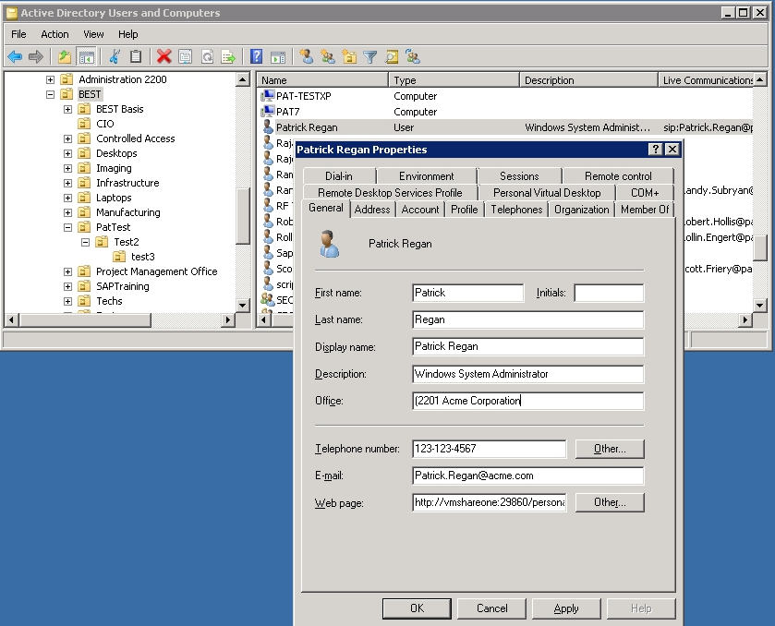
Domain User

Slide 31
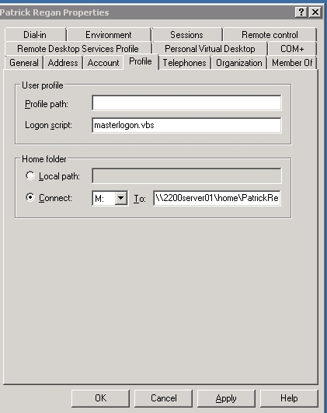
Domain User

Slide 32
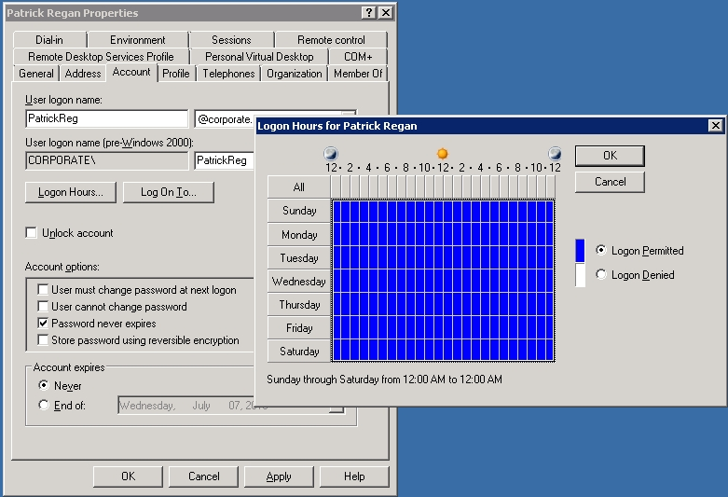
Domain User

Slide 33
Computer Account
Like user accounts, Windows computer accounts provide a means for authenticating and auditing the computer’s access to a Windows network and its access to domain resources.
Each Windows computer to which you want to grant access to resources must have a unique computer account.
It can also be used for auditing purposes specifying what system was used when something was accessed.

Slide 34
Computer Account
Like user accounts, computer accounts are assigned passwords when the computer is added to the domain, and those passwords are automatically maintained between the computer and the domain controllers.
Unfortunately, from time to time, a computer account can become untrusted where the security identifier (SID) or password is different from those stored in Active Directory.
Unfortunately, you cannot reset the password. Instead, the best thing to do is to rejoin the computer to the domain.
Notes:
This happens when:
You deploy a computer from an image of another computer and you do not use the sysprep tool to reset the SID.
The computer account is corrupted.
The computer is not connected to the domain network for long periods of time.

Slide 35
Groups
A group is a collection or list of user accounts or computer accounts.
Different from a container, the group does not store the user or computer, it just lists them.
The advantage of using groups is to simplify administration, especially when assigning rights and permissions.

Slide 36
Groups
Any group, whether it is a security group or a distribution group, is characterized by a scope that identifies the extent to which the group is applied in the domain tree or forest. The three group scopes are:
Domain Local group
Global group
Universal group

Slide 37
Group Policies
Group Policy is one of the most powerful features of Active Directory that controls the working environment for user accounts and computer accounts.
Group Policy provides the centralized management and configuration of operating systems, applications, and users’ settings in an Active Directory environment.

Slide 38
Group Policies
Group policies can be set locally on the workstation or can be set at different levels (site, domain, or organizational unit) within Active Directory.
Group policies are applied in the following order:
Local
Site
Domain
OU

Slide 39
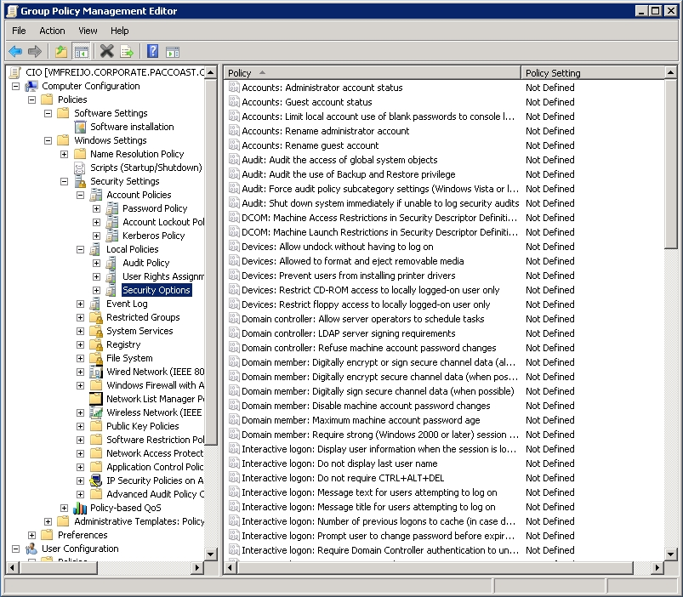
Group Policies

Slide 40
Rights
When specifying what a user can do on a system or to a resource is determined by two things: rights and permissions.
A user right authorizes a user to perform certain actions on a computer such as logging on to a system interactively or backing up files and directories on a system. User rights are assigned through local policies or Active Directory group policies.

Slide 41
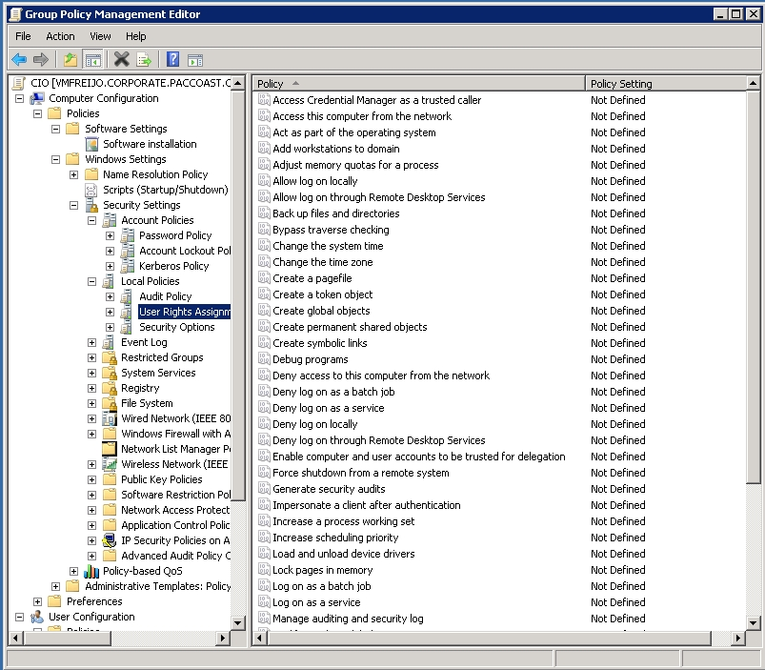
Group Policies

Slide 42
Permission
A permission defines the type of access that is granted to an object (an object can be identified with a security identifier) or object attribute.
The most common objects assigned permissions are NTFS files and folders, printers and Active Directory objects.
To keep track of which user can access an object and what the user can do is record in the access control list (ACL) which lists all users and groups that have access to the object.

Slide 43
Account Lockout Policy
An Account Lockout Policy specifies the number of unsuccessful logon attempts that, if made within a pre-defined amount of time, may hint of an unauthorized person trying to access a computer or the network.
An Account Lockout Policy can be set to lock the account in question after a specified number of invalid attempts.
Additionally, the policy specifies the duration that the account remains locked.

Slide 44
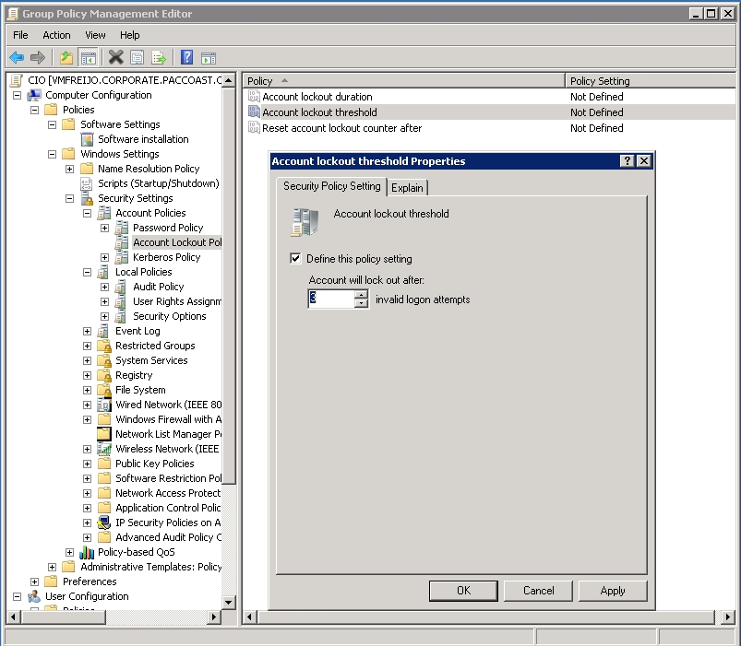
Account Lockout Policy

Slide 45
Password Control
Group policies can be used to control passwords including how often a user changes a password, how long the password is, and if the password is a complex password.
To help manage passwords, you can configure settings in the Computer Configuration\Windows Settings\Security Settings\Account Policies\Password Policy node of a group policy.

Slide 46
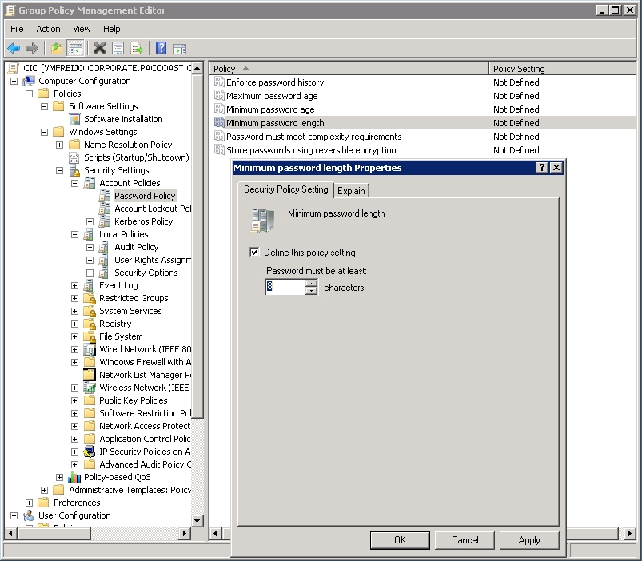
Password Control

Slide 47
Auditing
It is important that you protect your information and service resources from people who should not have access to them, and at the same time make those resources available to authorized users.
Auditing is not enabled by default. To enable auditing, you specify what types of system events to audit using group policies or the local security policy (Security Settings\Local Policies\Audit Policy).

Slide 48
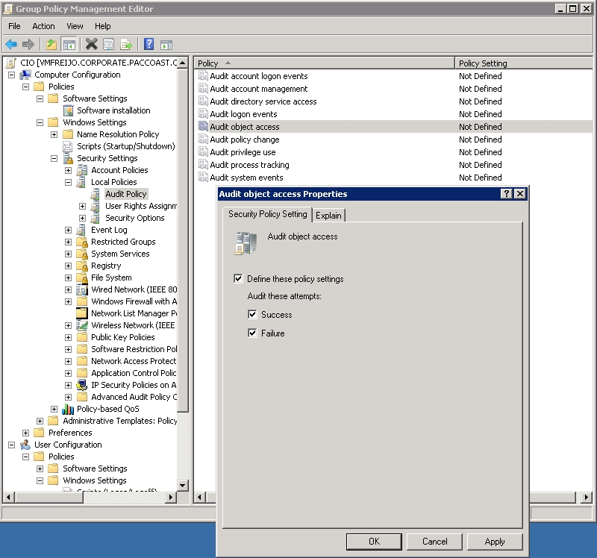
Auditing

Slide 49
Auditing
To audit NTFS files, NTFS folders, and printers is a two-step process. You must first enable Object Access using group policies. Then you must specify which objects you want to audit.

Slide 50
Troubleshooting Authentication Issues
Other items that you should check include:
When typing in your username and password, always check the caps lock and num lock keys first.
Make sure you have the correct language defined and that the keyboard is operating fine where all of the buttons click properly.
If the time is off, authentication can fail.
If your computer is no longer part of the domain or is no longer trusted, you will not be able to log in to the domain.

Slide 51
Troubleshooting Authentication Issues
Authentication issues are a common problem that everyone has to deal with.
The simplest and easiest mistake for users is forgetting their password, which then needs to be reset.
A common but easy mistake to make when typing a username or password is to have the caps lock or num lock key on.

Slide 52
Skill Summary
A workgroup is usually associated with a peer-to-peer network in which user accounts are decentralized and stored on each individual computer.
When you create a local user account on a computer running Windows 7, it is stored in the Security Accounts Manager (SAM). SAM is a database stored as a registry file.
A user account enables a user to log on to a computer and domain. As a result, it can be used to prove the identity of a user, which can then be used to determine what a user can access and what kind of access a user will have (authorization).
Notes:
Review the Skill Summary to wrap up your lesson.

Slide 53
Skill Summary
Associated with a user account is the user profile, which is a collection of folders and data that store the user’s current desktop environment and application settings.
Credential Manager allows you to store credentials, such as usernames and passwords that you use to log on to websites or other computers on a network.

Slide 54
Skill Summary
Authentication is the process of identifying an individual, usually based on a username and password. After a user is authenticated, users can access network resources based on the user’s authorization.
Authorization is the process of giving individuals access to system objects based on their identity.
Auditing is the process of keeping track of a user’s activity while accessing the network resources, including the amount of time spent in the network, the services accessed while there, and the amount of data transferred during the session.

Slide 55
Skill Summary
Active Directory is a directory service and technology created by Microsoft that provides a variety of network services, including LDAP, Kerberos-based and single sign-on authentication, DNS-based naming, and other network information, as well as a central location for network administration and delegation of authority.

Slide 56
Skill Summary
A Windows domain is a logical unit of computers and network resources that define a security boundary. A domain uses a single Active Directory database to share its common security and user account information for all computers within the domain, allowing centralized administration of all users, groups, and resources on the network.

Slide 57
Skill Summary
A server that is not running as a domain controller is known as a member server.
A domain controller is a Windows server that stores a replica of the account and security information of the domain and defines the domain boundaries.
To help organize objects within a domain and minimize the number of domains, you can use organizational units (OUs).

Slide 58
Skill Summary
A server that is not running as a domain controller is known as a member server.
A domain controller is a Windows server that stores a replica of the account and security information of the domain and defines the domain boundaries.
To help organize objects within a domain and minimize the number of domains, you can use organizational units (OUs).

Slide 59
Skill Summary
Like user accounts, Windows computer accounts provide a means for authenticating and auditing the computer’s access to a Windows network and its access to domain resources.
A group is a collection or list of user accounts or computer accounts.
Group Policy provides the centralized management and configuration of operating systems, applications and users’ settings in an Active Directory environment.

Slide 60
Skill Summary
A user right authorizes a user to perform certain actions on a computer such as logging on to a system interactively or backing up files and directories on a system.
A permission defines the type of access that is granted to an object (an object can be identified with a security identifier) or object attribute.

Slide 61
Skill Summary
An Account Lockout Policy specifies the number of unsuccessful logon attempts that, if made within a pre-defined amount of time, may hint of an unauthorized person trying to access a computer or the network.
To help protect against someone guessing a user’s login password, users should change their passwords regularly.

